Slide 1
Vali IT
SQL

Slide 2
Ülesanded (vanad)
BankController
RandomGame to web requests

Slide 3
Install PostgreSql or…..

Slide 4
Install Docker

Slide 5
Run postgre
docker volume create postgres-data
docker run --name pg -e POSTGRES_PASSWORD=docker -d -p 5432:5432 --mount source=postgre-data,target=/var/lib/postgresql/data postgres

Slide 6
Docker commands
docker start pg
docker stop pg

Slide 7
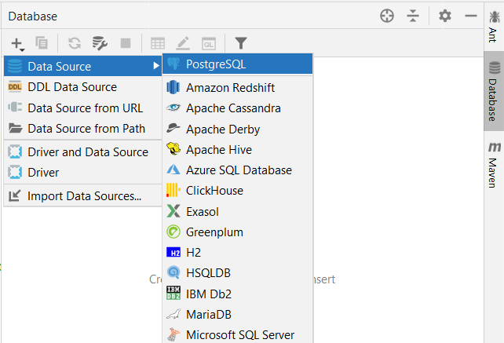
Connect Intellij to local database

Slide 8
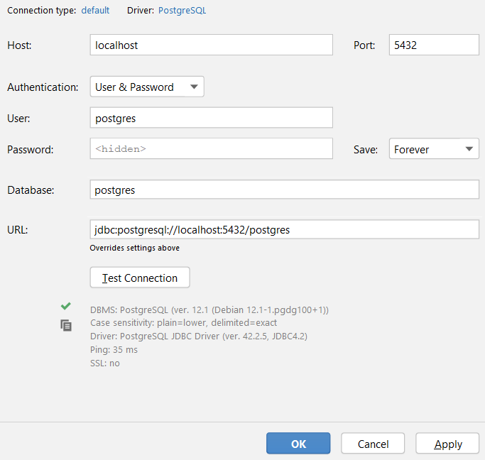
Connect Intellij to local database

Slide 9
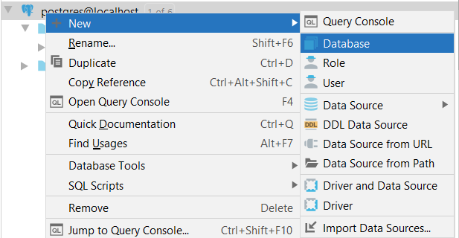
Create new database (don’t use postgre)

Slide 10
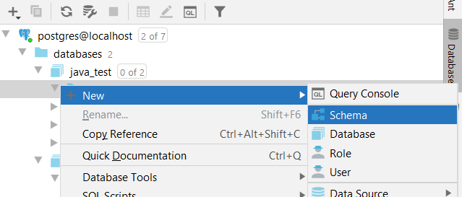
Create public schema

Slide 11
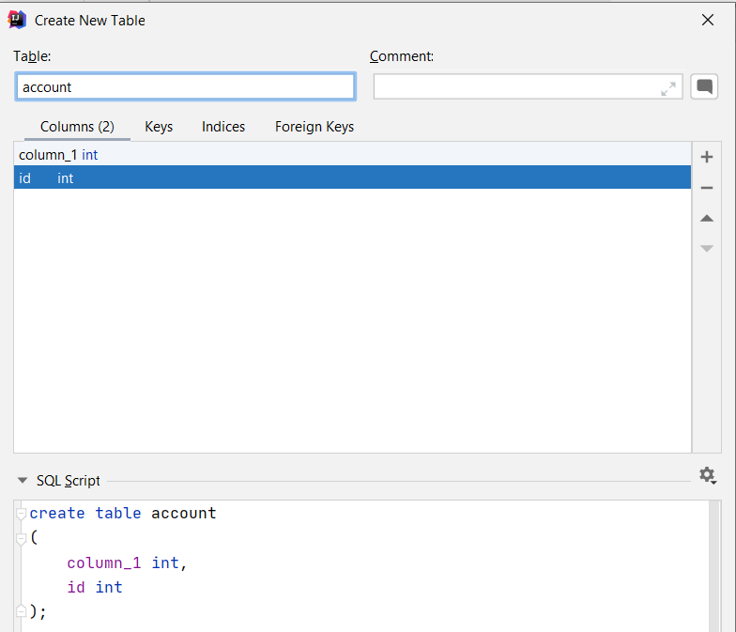
Create tables within public schema
Nice editor
SQL

Slide 12
Database design
Data is stored in tables
Tables store data with specified structure
You can define relations betwen databases

Slide 13
Users
User
id | first_name | last_name | role
1 | Mari | Maasikas | Administrator
2 | Kristo | Kaalikas | User
3 | Lembit | Liblikas | User
4 | Märt | Maadleja | Editor
5 | Ene | Eskimo | Moderator

Slide 14
Users with many roles
User
id | first_name | last_name | role
1 | Mari | Maasikas | Administrator
2 | Kristo | Kaalikas | User
3 | Lembit | Liblikas | User
4 | Märt | Maadleja | Editor, Moderator
5 | Ene | Eskimo | Moderator

Slide 15
Multiple tables
User
id | first_name | last_name | username | email
1 | Mari | Maasikas | mari.maasikas | mari.maasikas@gmail.com
2 | Kristo | Kaalikas | kristo.kaalikas | kristo.kaalikas@gmail.com
3 | Lembit | Liblikas | lembit.liblikas | lemps123@mail.ee
4 | Märt | Maadleja | mart.maadleja | mart@autoremont.ee
5 | Ene | Eskimo | ene.eskimo | ene.eskomo3@yahoo.com
Role
id | name
1 | Administrator
2 | Moderator
3 | Editor
4 | User

Slide 16
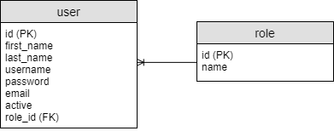
One to many relation
User
id | first_name | last_name | username | email | role_id
1 | Mari | Maasikas | mari.maasikas | mari.maasikas@gmail.com | 1
2 | Kristo | Kaalikas | kristo.kaalikas | kristo.kaalikas@gmail.com | 4
3 | Lembit | Liblikas | lembit.liblikas | lemps123@mail.ee | 4
4 | Märt | Maadleja | mart.maadleja | mart@autoremont.ee | 3
5 | Ene | Eskimo | ene.eskimo | ene.eskomo3@yahoo.com | 2
Role
id | name
1 | Administrator
2 | Moderator
3 | Editor
4 | User

Slide 17
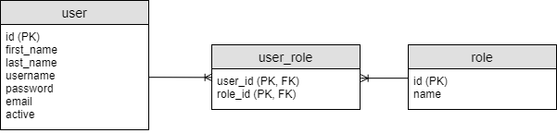
Many to many relation
User
id | first_name | last_name | username | email
1 | Mari | Maasikas | mari.maasikas | mari.maasikas@gmail.com
2 | Kristo | Kaalikas | kristo.kaalikas | kristo.kaalikas@gmail.com
3 | Lembit | Liblikas | lembit.liblikas | lemps123@mail.ee
4 | Märt | Maadleja | mart.maadleja | mart@autoremont.ee
5 | Ene | Eskimo | ene.eskimo | ene.eskomo3@yahoo.com
Role
id | name
1 | Administrator
2 | Moderator
3 | Editor
4 | User
User Role
user_id | role_id
1 | 1
2 | 4
3 | 4
4 | 3
5 | 2
4 | 2

Slide 18
Create bank dabase tables
Customers
Accounts
Transaction History

Slide 19
SQL - INSERT
INSERT INTO table_name (column1, column2) VALUES (‘value1’, ‘value2’);

Slide 20
SQL - SELECT
SELECT * FROM table_name;
SELECT column1, column2 FROM table_name;
SELECT * FROM table_name where column_name = ‘column_value’;

Slide 21
SQL - UPDATE
UPDATE table_name SET column_name = ‘column_value’ WHERE id = 5;

Slide 22
SQL - DELETE
DELETE FROM table_name WHERE id = 5;

Slide 23
application.properties
spring.datasource.url=jdbc:postgresql://localhost/db_name spring.datasource.username=postgres spring.datasource.password=docker spring.datasource.driver-class-name=org.postgresql.Driver

Slide 24
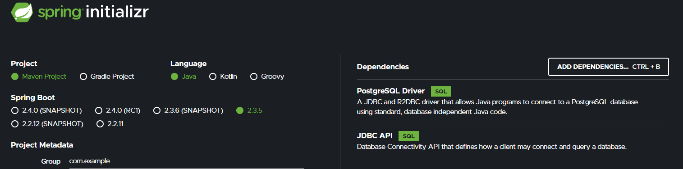
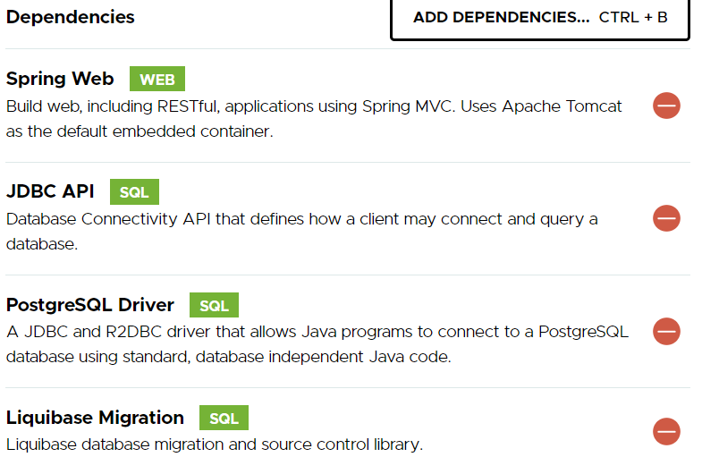
Make new project at: start.spring.io

Slide 25
Application.properties
In src/main/resources application.properties add:
spring.datasource.url=jdbc:postgresql://localhost/postgres spring.datasource.username=postgres spring.datasource.password=password spring.datasource.driver-class-name=org.postgresql.Driver

Slide 26

Normal way vs Dependency Injection

Slide 27
Inversion of Control
It is a process whereby objects define their dependencies, but don’t instanciate them
The container injects those dependencies
This process is fundamentally the inverse, hence the name Inversion of Control (IoC),
Also known as Dependency Injection

Slide 28
Spring Bean
In Spring, the objects that are managed by the Spring IoC container are called beans.
ApplicationContext represents the Spring IoC container and is responsible for instantiating, configuring, and assembling beans.
https://docs.spring.io/spring/docs/3.2.x/spring-framework-reference/html/beans.html

Slide 29
Bean Creation
Many Beans are automatically created by Spring Framework
All classes that are annotated with @Component annotation is a bean. (incuding @RestController, @Controller, @Service, @Repository, …)

Slide 30
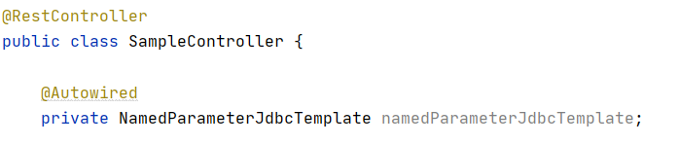
Using Beans @Autowired
If class variable has @Autowired annotation the field is automatically instantiated

Slide 31
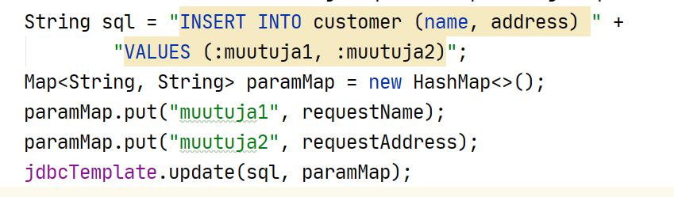
Non Select Statements

Slide 32
Ülesanded
BankController
1.1) createAccount
1.2) getAccount
1.3) depositMoney
1.4) withdrawMoney
1.5) transferMoney

Slide 33
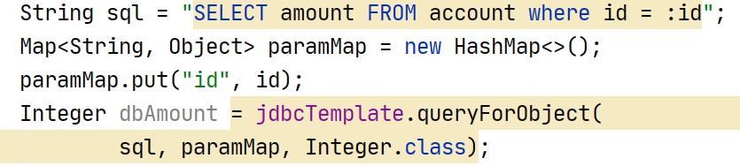
Select 1 column 1 row

Slide 34
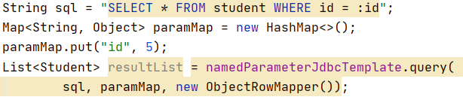
Select multiple rows, multiple columns
SQL-is olev muutuja

Slide 35
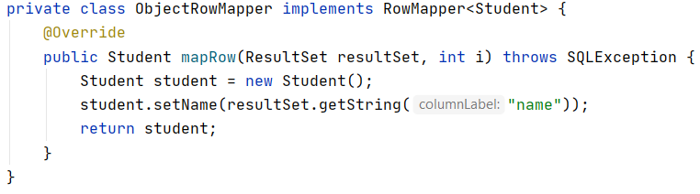
RowMapper

